Slide 1
Micro Credit Loan Defaulter Project
Notes:
Project

Slide 2
Problem Statement
Improve the selection of customers for the credit
Predictive model that improves selection of customer
Notes:
Can we include some examples here?
Here explain in a single line or two, what is the problem you are solving.
What could be the possible business problems that are related to the data science problem you are solving?

Slide 3
Why solve this problem?
Identifying customers that are defaulters in loan repayment
Reduce Loan default cases
Assumptions
Maximum amount taken as a loan will increase the probability of being defaulter.
Notes:
Why solving this problem is important? - Business Impact
Who are the stakeholders for whom you are presenting the solution? - CEO, CFO, Marketing, Sales etc
Any important assumptions you are making.

Slide 4
Data
Label-- Flag indicating whether the user paid back the credit amount within 5 days of issuing the loan {1:success, 0:failure}
msisdn -- mobile number of user
aon -- age on cellular network in days
daily_decr30-- Daily amount spent from main account, averaged over last 30 days (in Indonesian Rupiah)
daily_decr90-- Daily amount spent from main account, averaged over last 90 days (in Indonesian Rupiah)
rental30-- Average main account balance over last 30 days
rental90-- Average main account balance over last 90 days
last_rech_date_ma-- Number of days till last recharge of main account
last_rech_date_da-- Number of days till last recharge of data account last_rech_amt_ma-- Amount of last recharge of main account (in Indonesian Rupiah)
cnt_ma_rech30-- Number of times main account got recharged in last 30 days
fr_ma_rech30-- Frequency of main account recharged in last 30 days
sumamnt_ma_rech30-- Total amount of recharge in main account over last 30 days (in Indonesian Rupiah)
medianamnt_ma_rech30-- Median of amount of recharges done in main account over last 30 days at user level (in Indonesian Rupiah)
medianmarechprebal30-- Median of main account balance just before recharge in last 30 days at user level (in Indonesian Rupiah)
cnt_ma_rech90-- Number of times main account got recharged in last 90 days
fr_ma_rech90-- Frequency of main account recharged in last 90 days
sumamnt_ma_rech90-- Total amount of recharge in main account over last 90 days (in Indonasian Rupiah)
medianamnt_ma_rech90-- Median of amount of recharges done in main account over last 90 days at user level (in Indonasian Rupiah)
medianmarechprebal90-- Median of main account balance just before recharge in last 90 days at user level (in Indonasian Rupiah)
cnt_da_rech30-- Number of times data account got recharged in last 30 days
Notes:
What are the data points you currently have in the dataset?
If you had the opportunity, what additional data you would love to have?
You currently have all the data you need available to you a csv, however in real life thats NEVER going to be the case. You will be requesting, extracting the data from multiple different sources. Though we are sharing the data with you, take sometime to think about all the different sources of data that you will need access from the provider to put together this kind of dataset eventually. This should be a key insight on your final report

Slide 5
Data
fr_da_rech90-- Frequency of data account recharged in last 90 days
cnt_loans30-- Number of loans taken by user in last 30 days
amnt_loans30-- Total amount of loans taken by user in last 30 days
maxamnt_loans30-- maximum amount of loan taken by the user in last 30 days
medianamnt_loans30-- Median of amounts of loan taken by the user in last 30 days
cnt_loans90-- Number of loans taken by user in last 90 days
amnt_loans90-- Total amount of loans taken by user in last 90 days
maxamnt_loans90-- maximum amount of loan taken by the user in last 90 days
medianamnt_loans90-- Median of amounts of loan taken by the user in last 90 days
payback30-- Average payback time in days over last 30 days
payback90-- Average payback time in days over last 90 days
pcircle-- telecom circle
pdate-- date

Slide 6
Exploratory Data Analysis
Notes:
Put across the EDA that is most interesting and relevant to the problem.
For each of the Data visualizations being showcased, put the business relevant insight, and bring out how are you using this insight later in problem solving.
Put the most insightful 2-3 data visualizations and rest of EDA summarize. Let jupyter notebook stay as is, this is a crisp summary ONLY

Slide 7
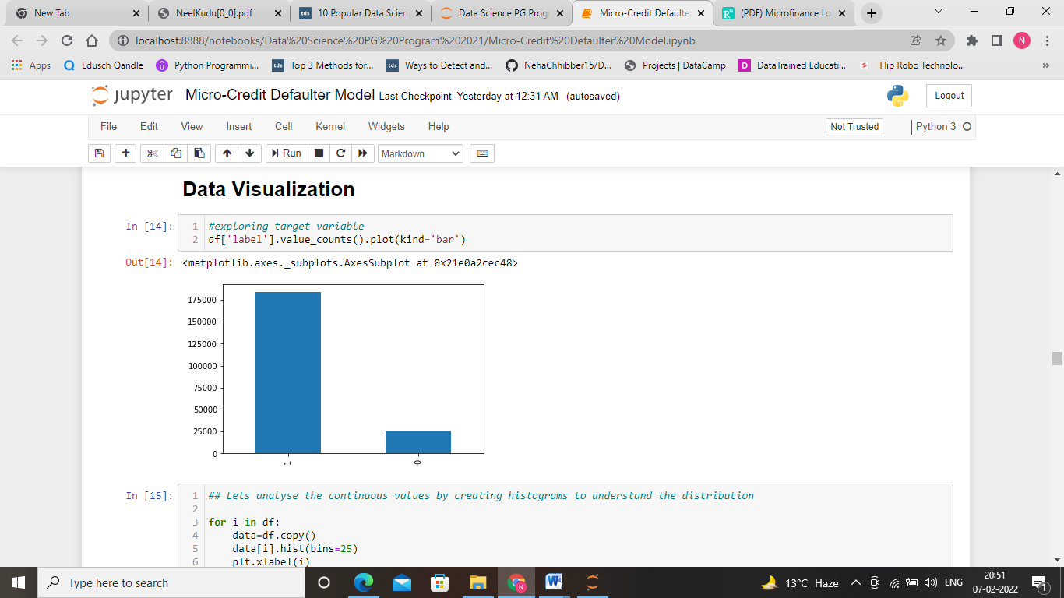
Data imbalance
Notes:
Here, we can see the bar graph of our target variable, 1 depict the Non-defaulter and 0 depict the defaulter. We can see that there is a huge gap between both the bars which means our target variable is highly imbalanced.

Slide 8
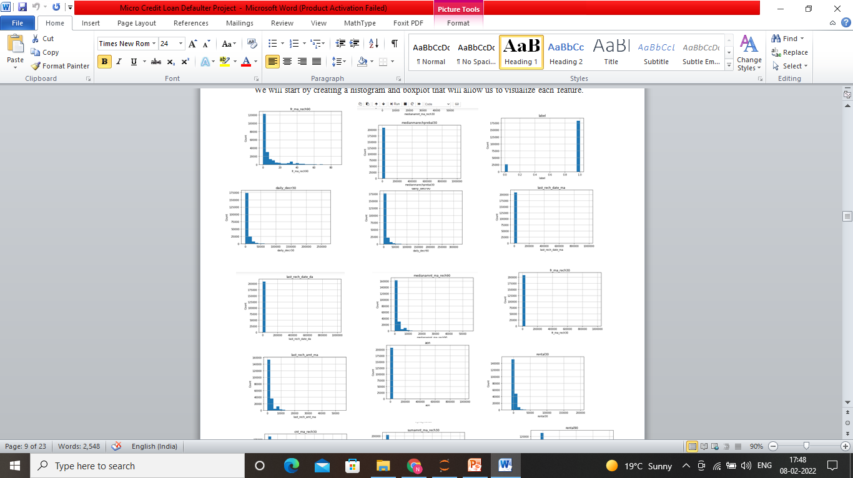
Histogram for few of the features :
Notes:
Here, we can visualize that the data is skewed. So, we need to scale the data.

Slide 9
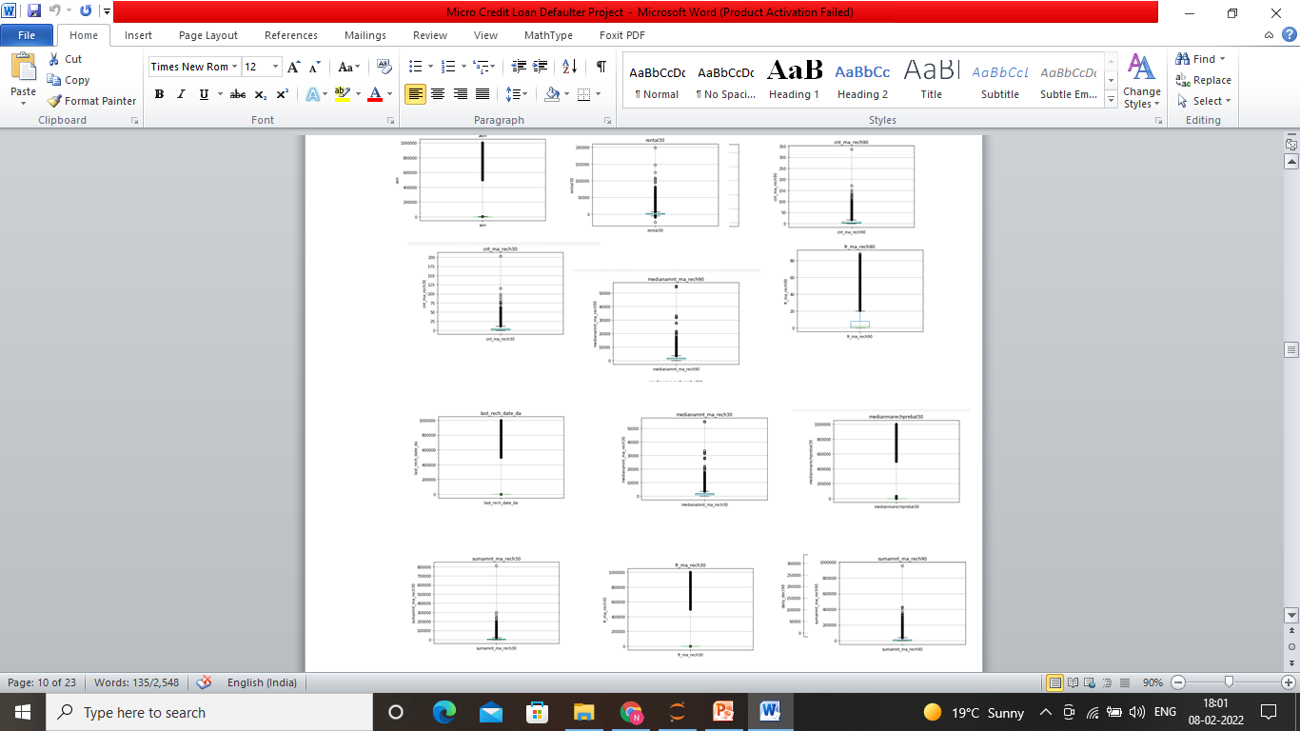
Box Plot:
Notes:
Here, we can see boxplot for few of the features. It shows that many outliers are present in the given dataset. We need to handle it.

Slide 10
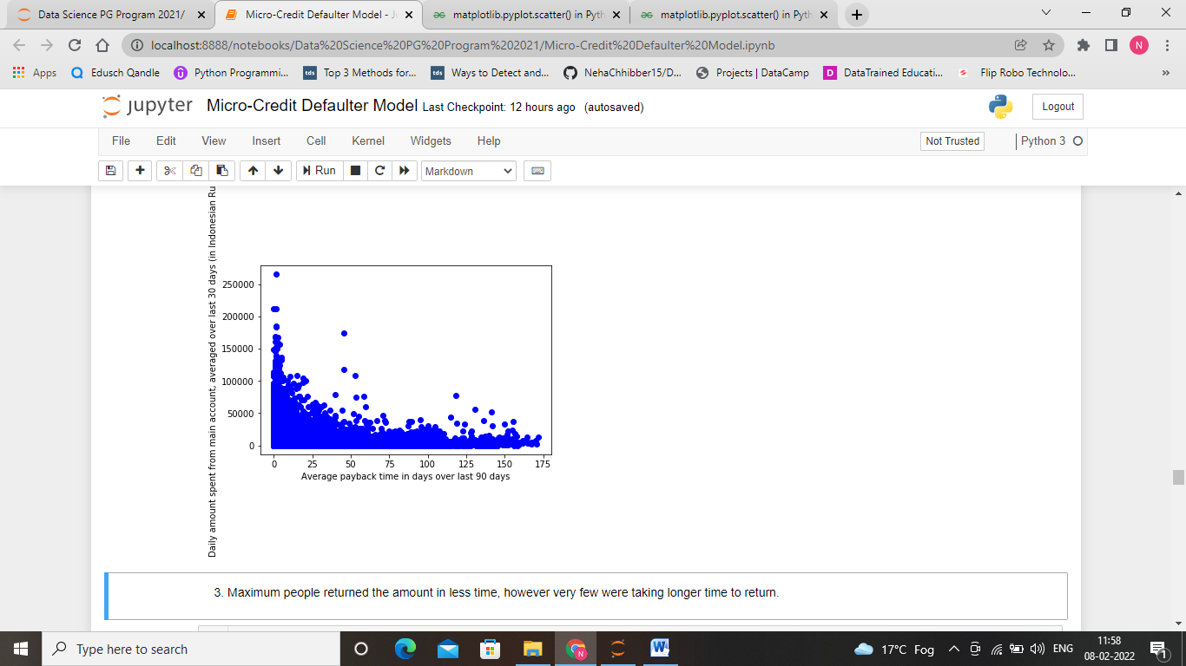
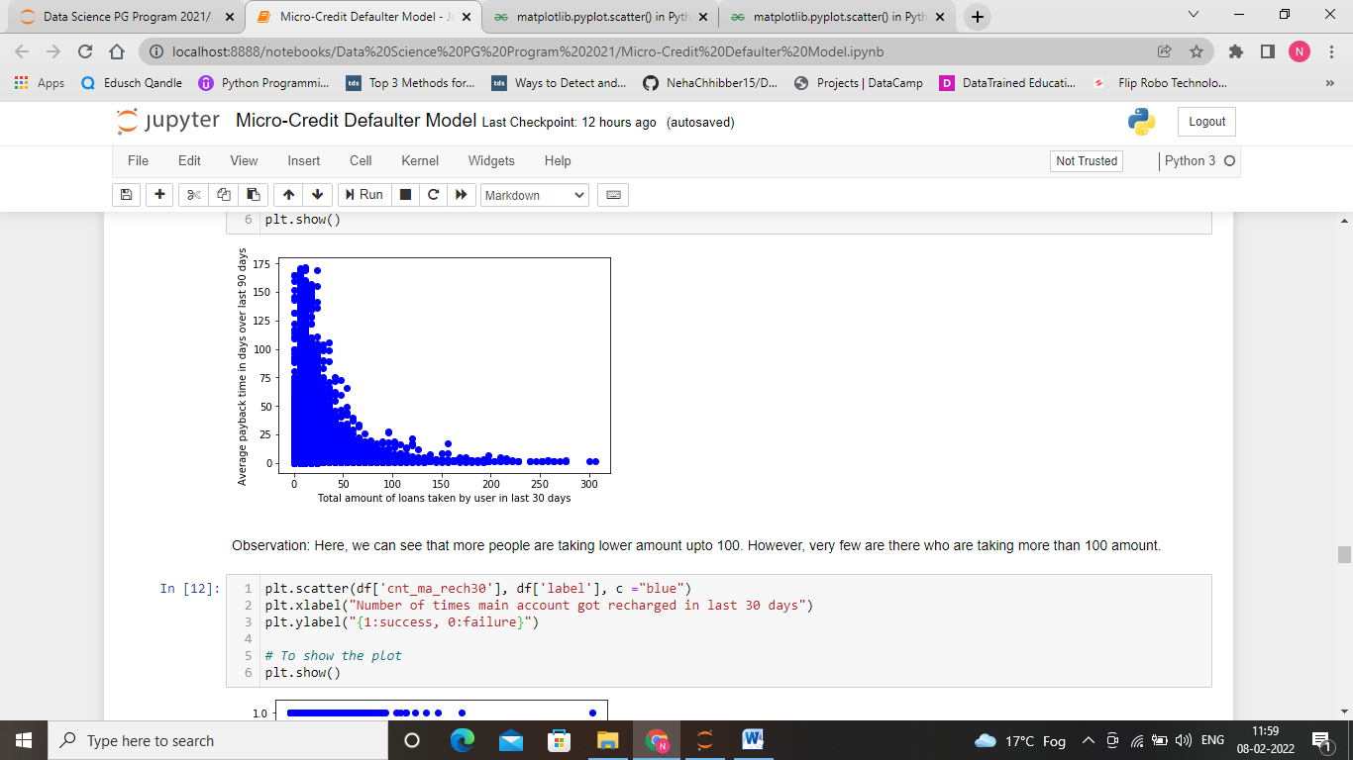
Bivariable Analysis

Slide 11
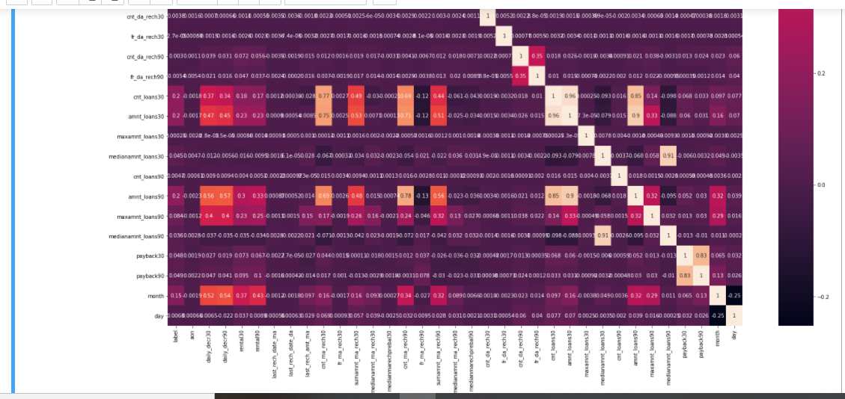
Correlation Matrix
Notes:
Observation: Here, we can see that some of the features are very less correlated that are 'fr_da_rech90','maxamnt_loans30','cnt_da_rech30','cnt_da_rech90','last_rech_date_da','maxamnt_loans90','medianamnt_loans90','medianamnt_loans30'.

Slide 12
Exploratory data analysis
Number of days till last recharge of main account: days are ranging from 1 to 7
Number of days till last recharge of data account: No information is given in this column
Amount of last recharge of main account (in Indonesian Rupiah): average recharge of rupiah is approx 1500.
Number of loans taken by user in last 30 days: On an average two loans are taken by account holder.
Total amount of loans taken by user in last 30 days: On an average 12 rupiah
Maximum amount of loan taken by the user in last 30 days: There are only two options: 5 & 10 Rs., for which the user needs to pay back 6 & 12 Rs. respectively
Median of amounts of loan taken by the user in last 30 days: 3
Number of loans taken by user in last 90 days: on an average people use to take 2 loans
Total amount of loans taken by user in last 90 days: The amount varies from 6 to 438. However, average amount is 12. 32: maximum amount of loan taken by the user in last 90 days: on an average 6
Median of amounts of loan taken by the user in last 90 days: varies from 0 to 3
Average payback time in days over last 30 days: average of 3 days
Average payback time in days over last 90 days: average of 4 days.

Slide 13
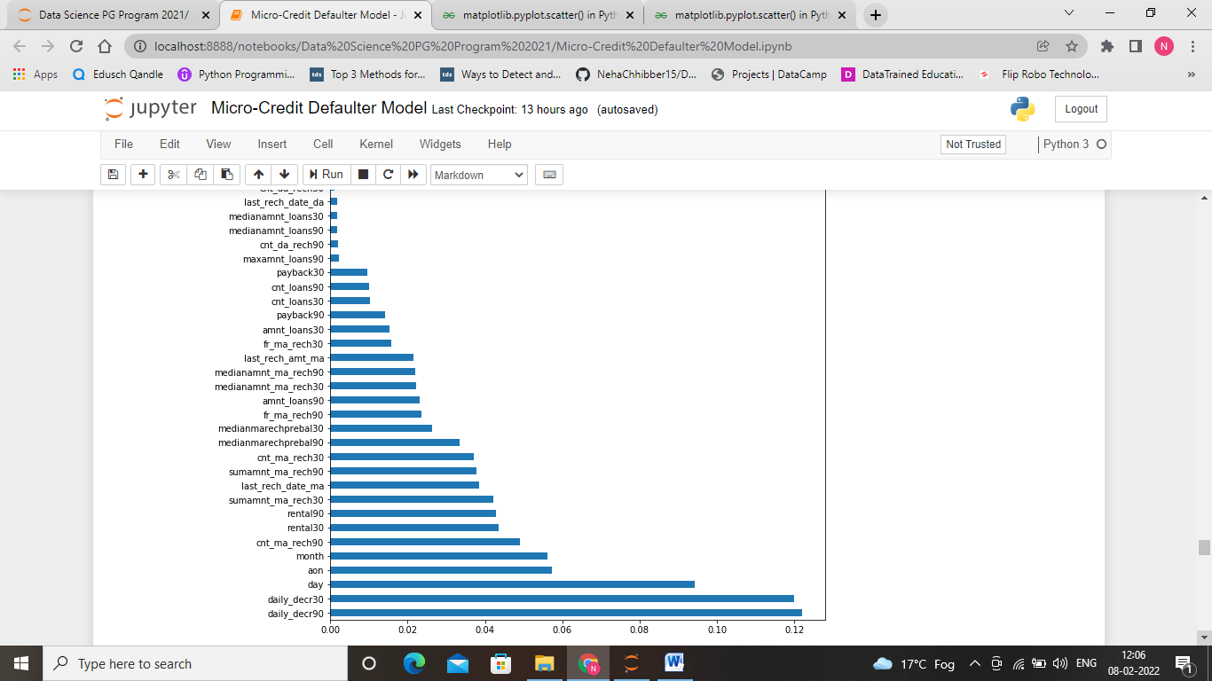
Feature Selection
Here, we have to find out which feature are most important and which features are least important. As per the weightage of importance we are selecting these features.

Slide 14
OPTIONS OF MACHINE LEARNING ALGORITHMS
Base Models
K-Nearest Neighbour Classifier
Logistic Regression
Decision Tree Classifier
Random Forest Classifier
AdaBoost Classifier
GradientBoosting Classifier
XGBoost Classifier
Ensemble Methods

Slide 15
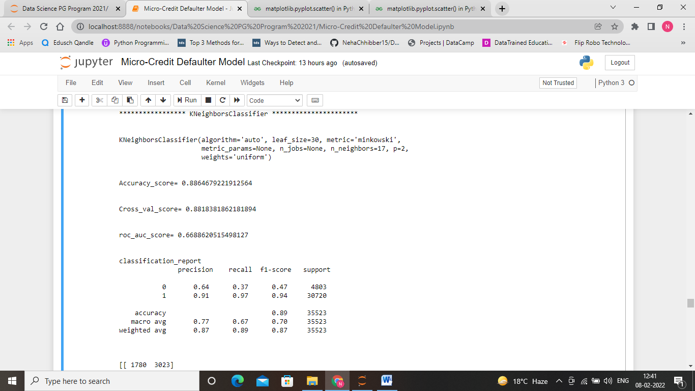
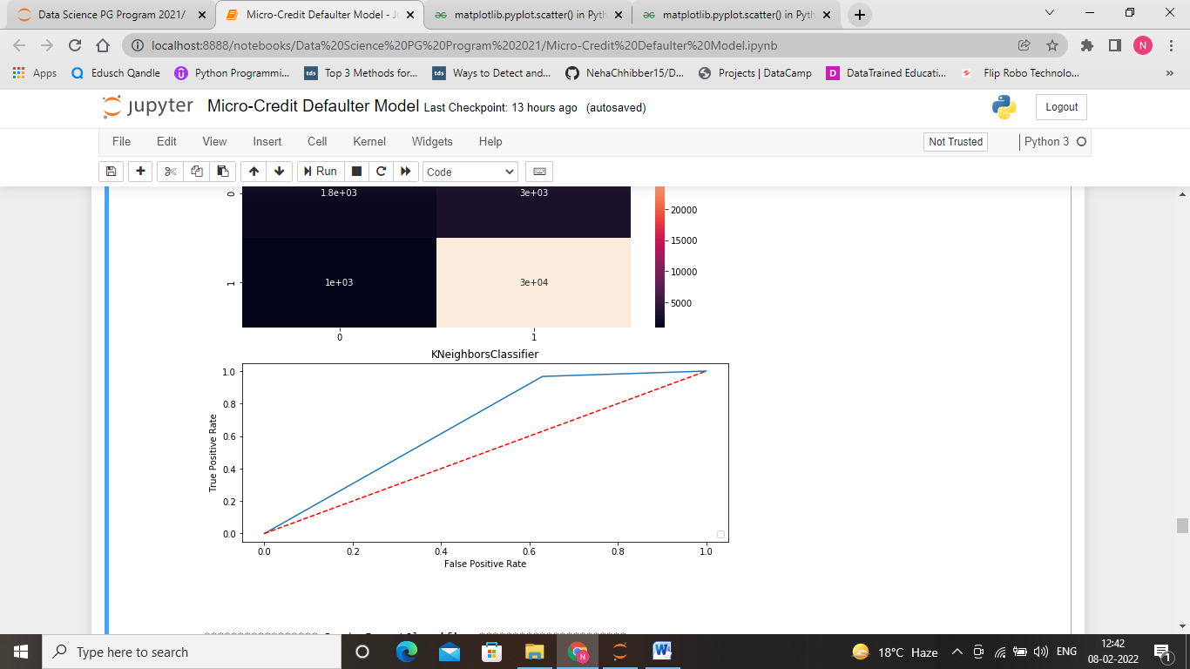
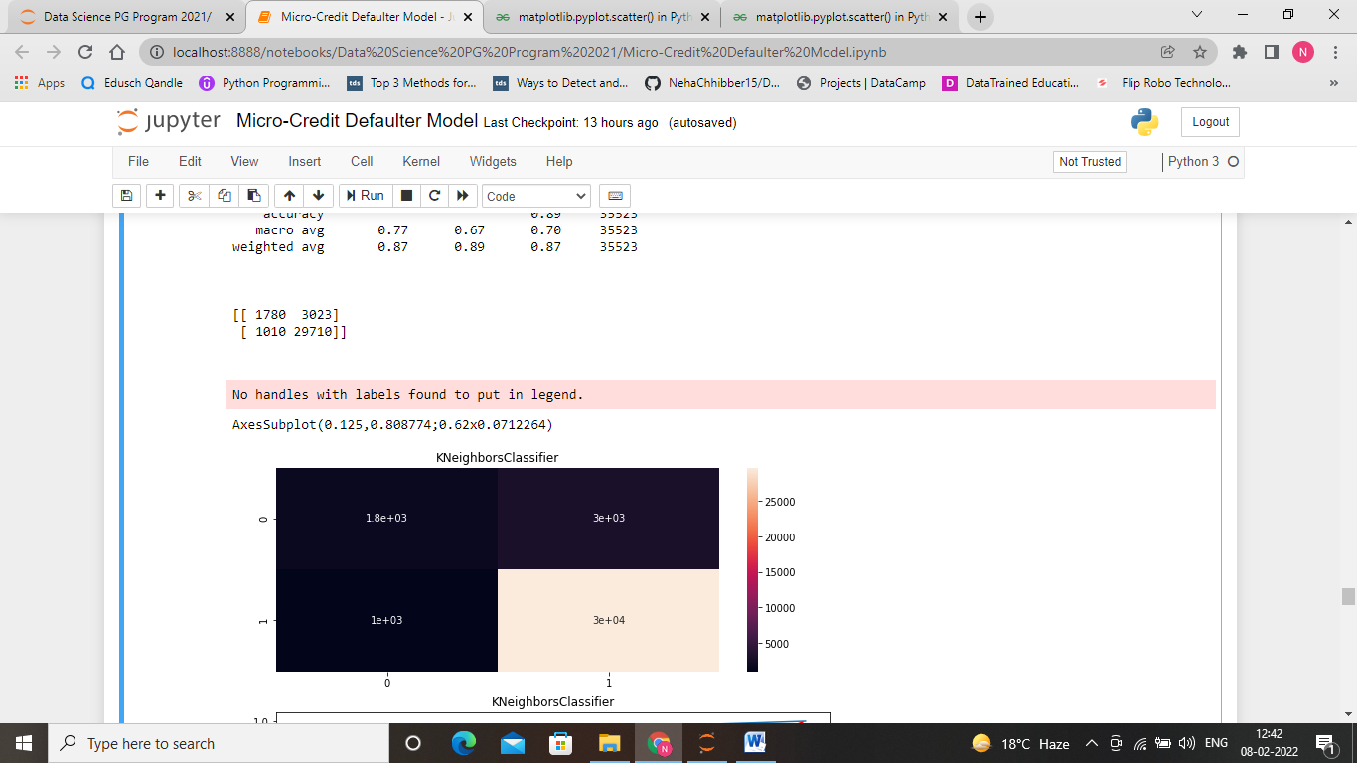
Kneighbour Classifier after Hyperparameter Tuning

Slide 16
Choice of evaluation metric
The goal of the model is to identify the fraudulent transactions.
The focus is to minimize False Negative predictions (Transaction which are Fraudulent and not predicted as Fraudulent)
Any evaluation metric taking into the “False Negatives” will be a fair deal.
We can choose “Precision score or F1 score ” as model evaluation metric

Slide 17
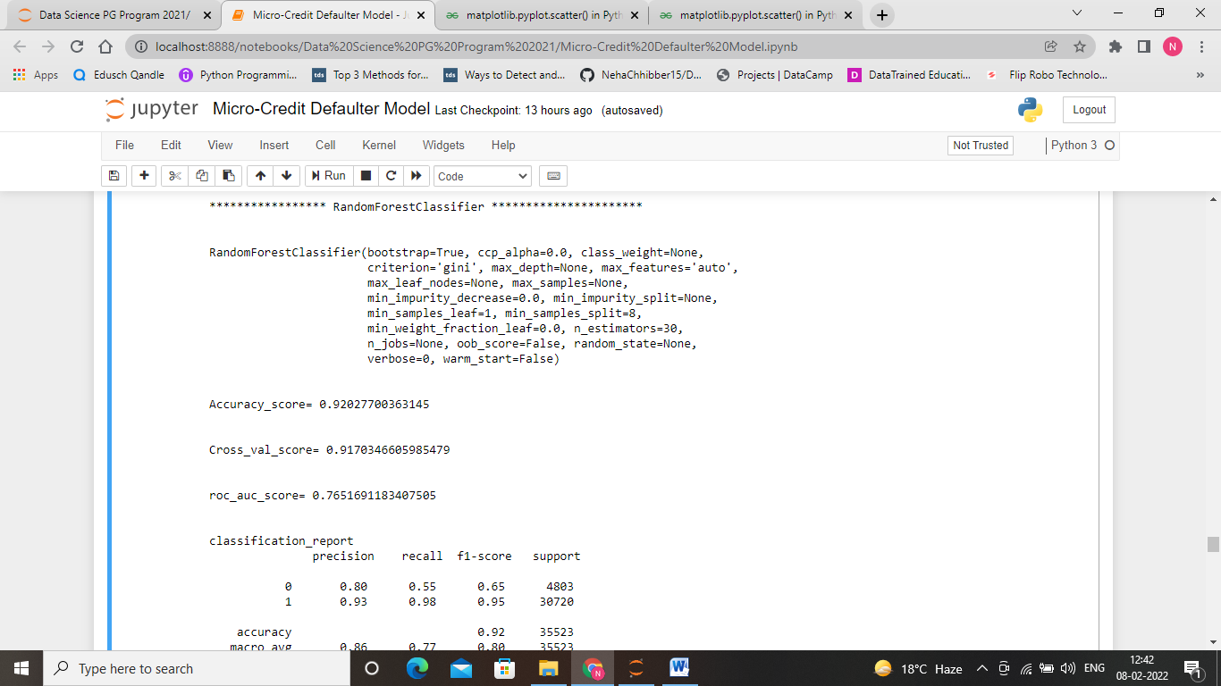
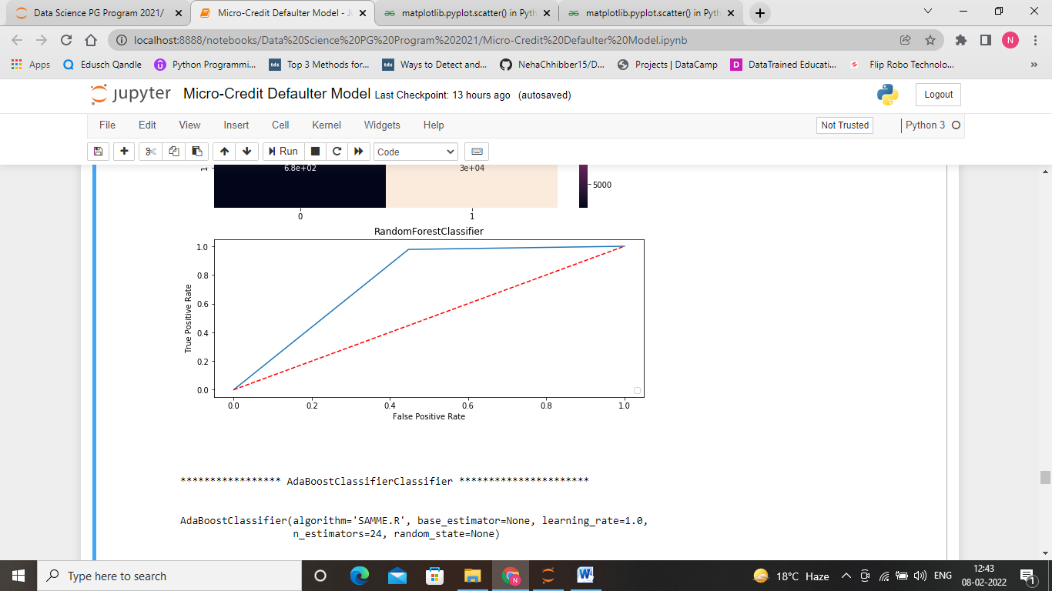
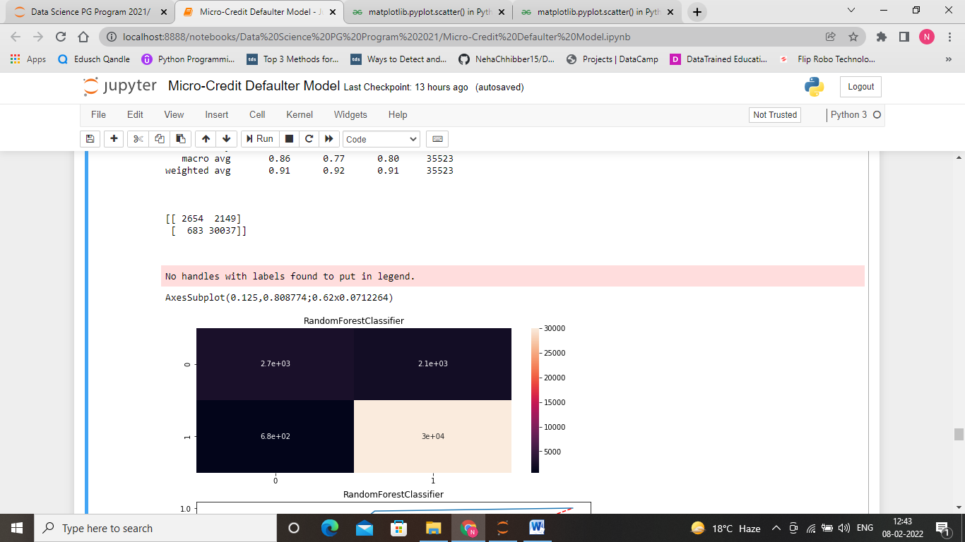
Random Forest Classifier after Hyperparameter tunning
Notes:
Here, we can see that maximum area is enclosed under ROC_AUC curve.

Slide 18

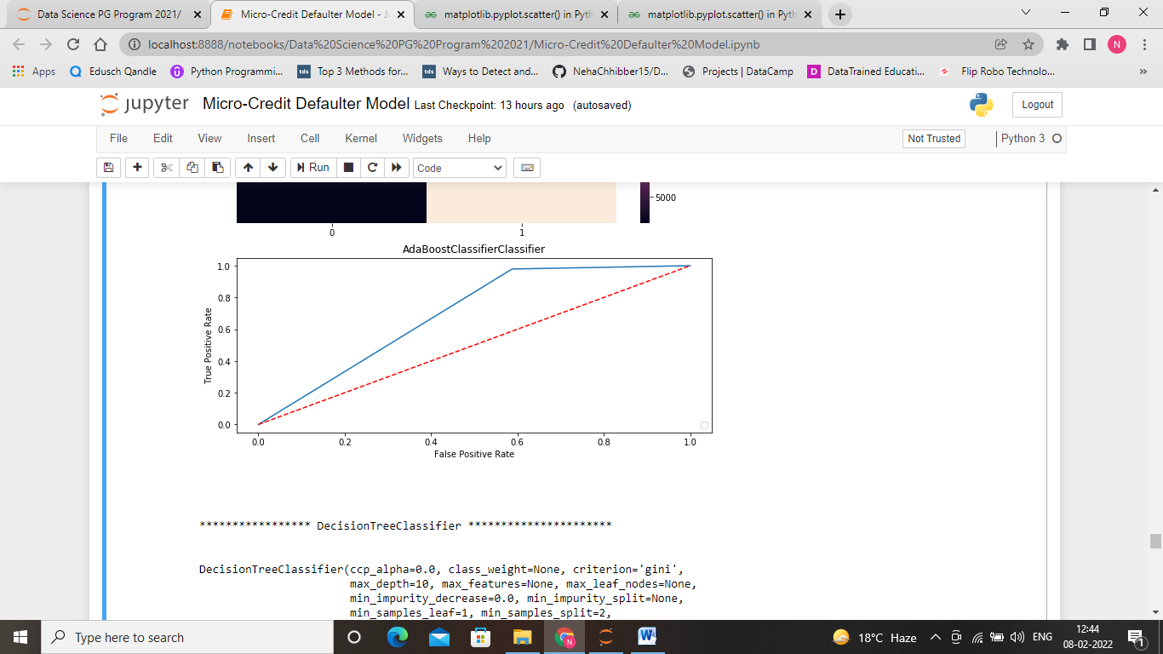
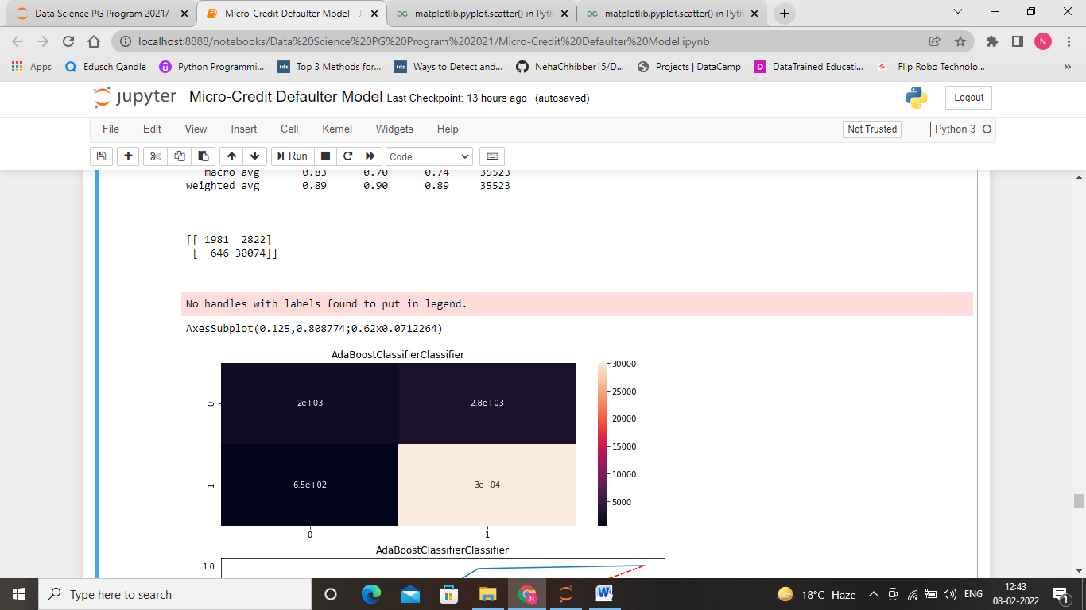
Adaboost Classifier after hyperparameter tunning

Slide 19

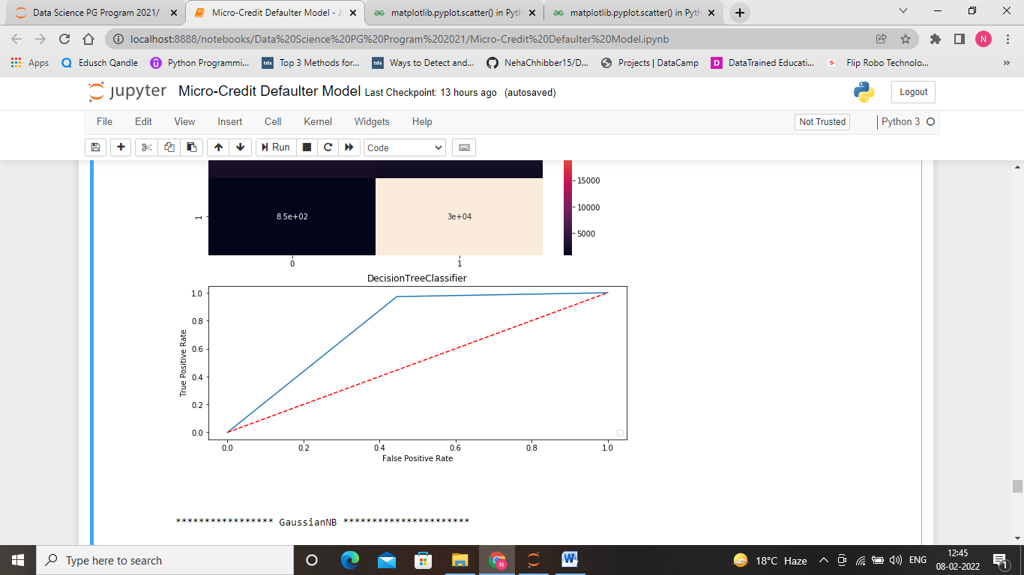
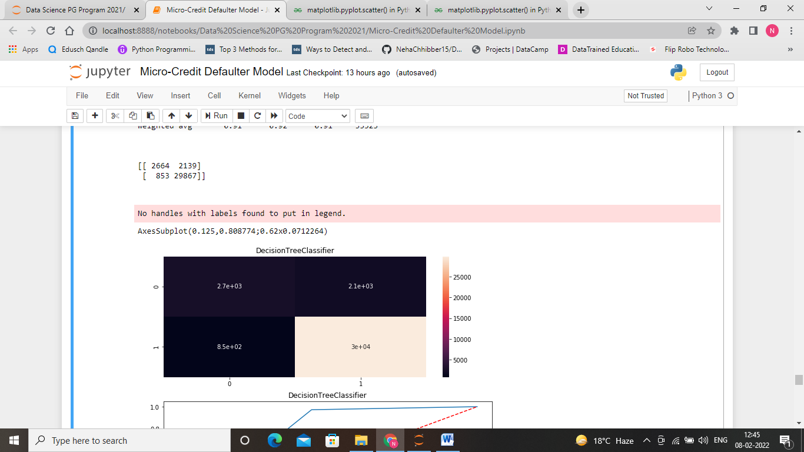
Decision Tree Classifier after Hyperparameter tunning

Slide 20
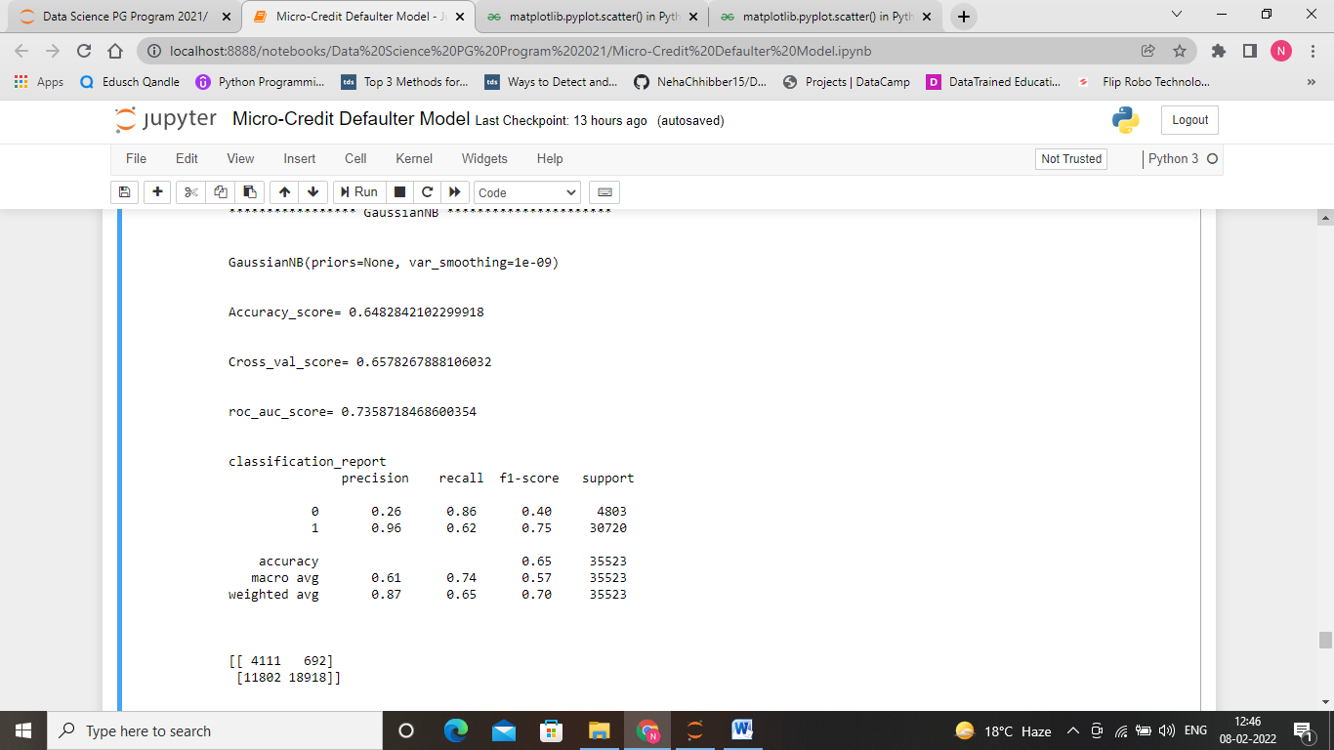
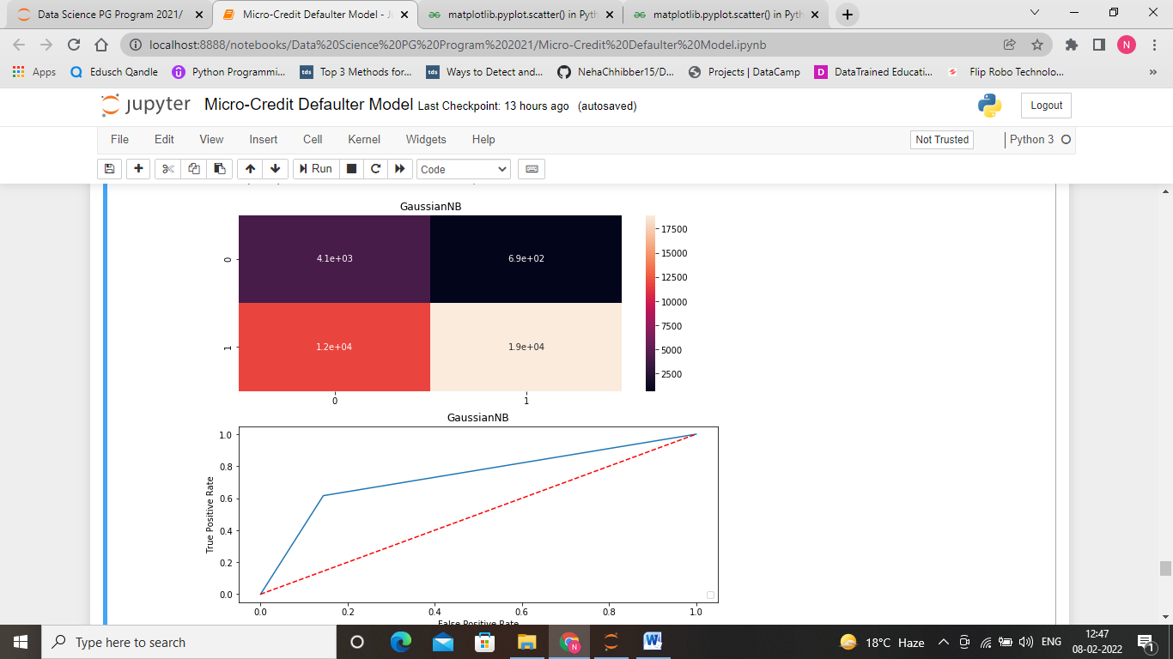
Gaussian NB after Hyperparameter tunning

Slide 21
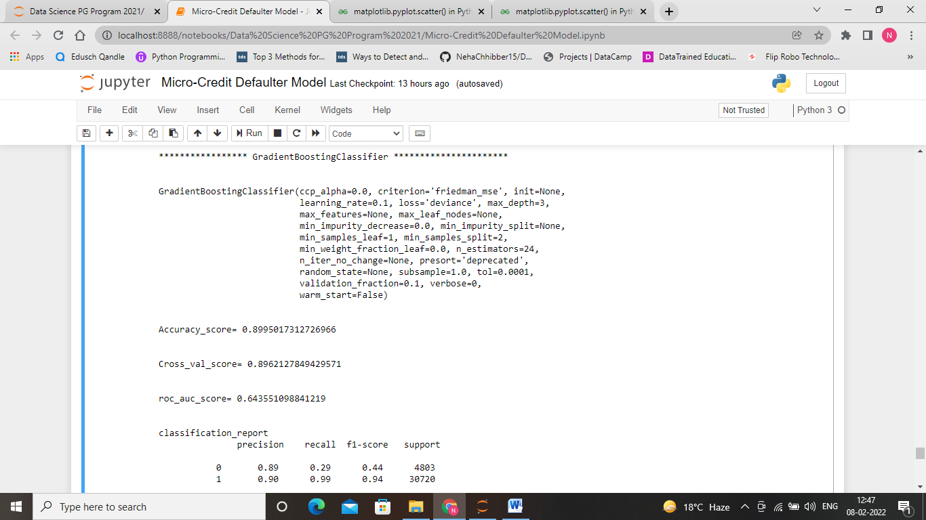
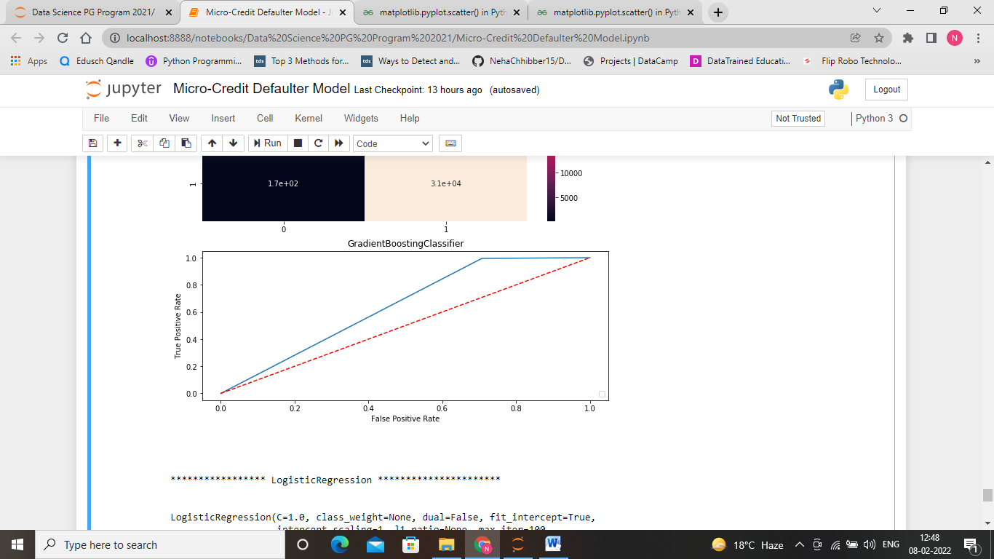
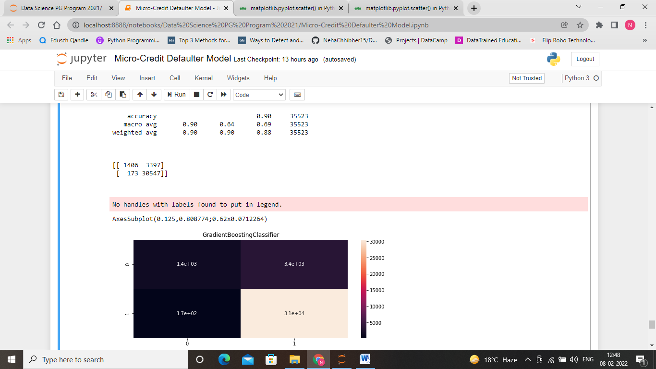
Gradiant Boosting Classifier using hyperparameter tunning

Slide 22

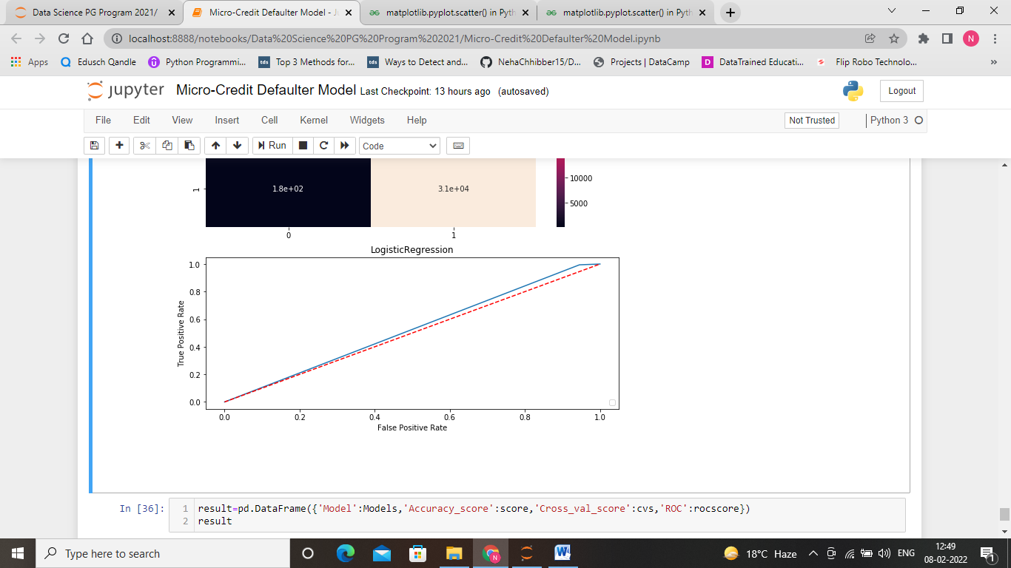
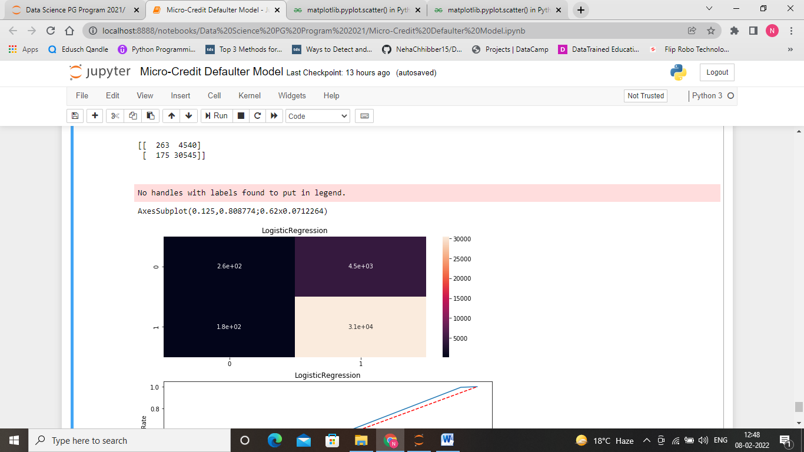
Logistic Regression using hyperparameter tunning

Slide 23
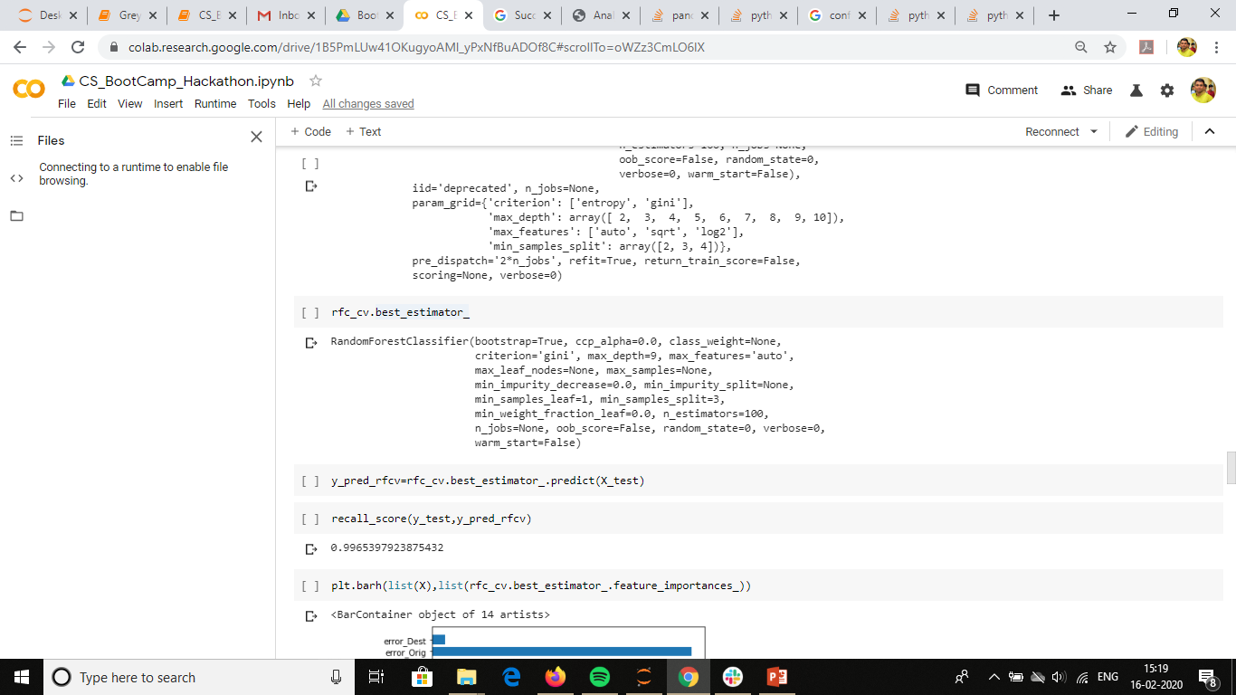
Best Model for random forest classifier

Slide 24
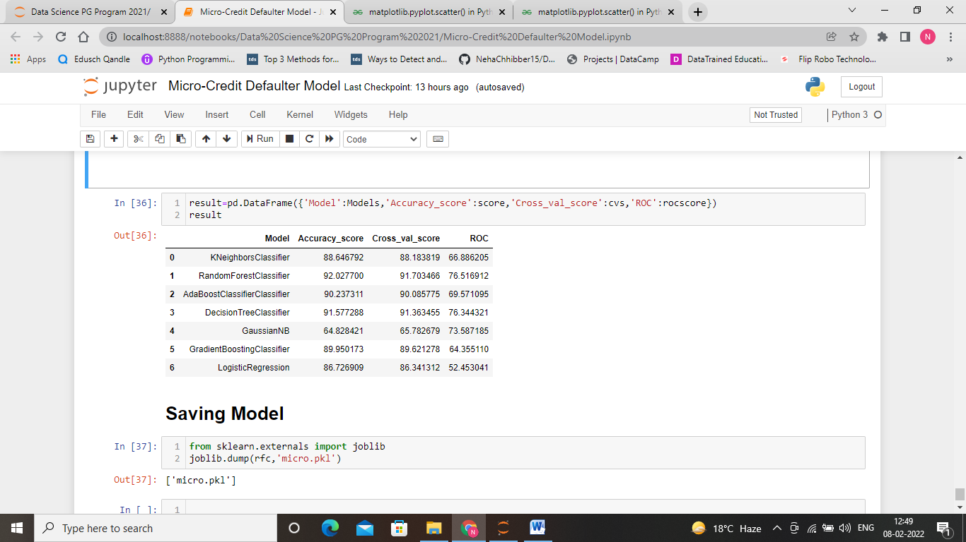
Random Forest is best Model
Notes:
On comparing values with rest of the model, we find that random forest classifier is the best model. For this we are getting a score of 92%.

Slide 25
Conclusion
Maximum number of loan taken by the person may increase the probability for being defaulter.
Maximum is the loan amount more is the probability of being defaulter.

